Slide 1
Sociology: 3549 Hypothesis testing
Recitation #9
Yue Chu

Slide 2
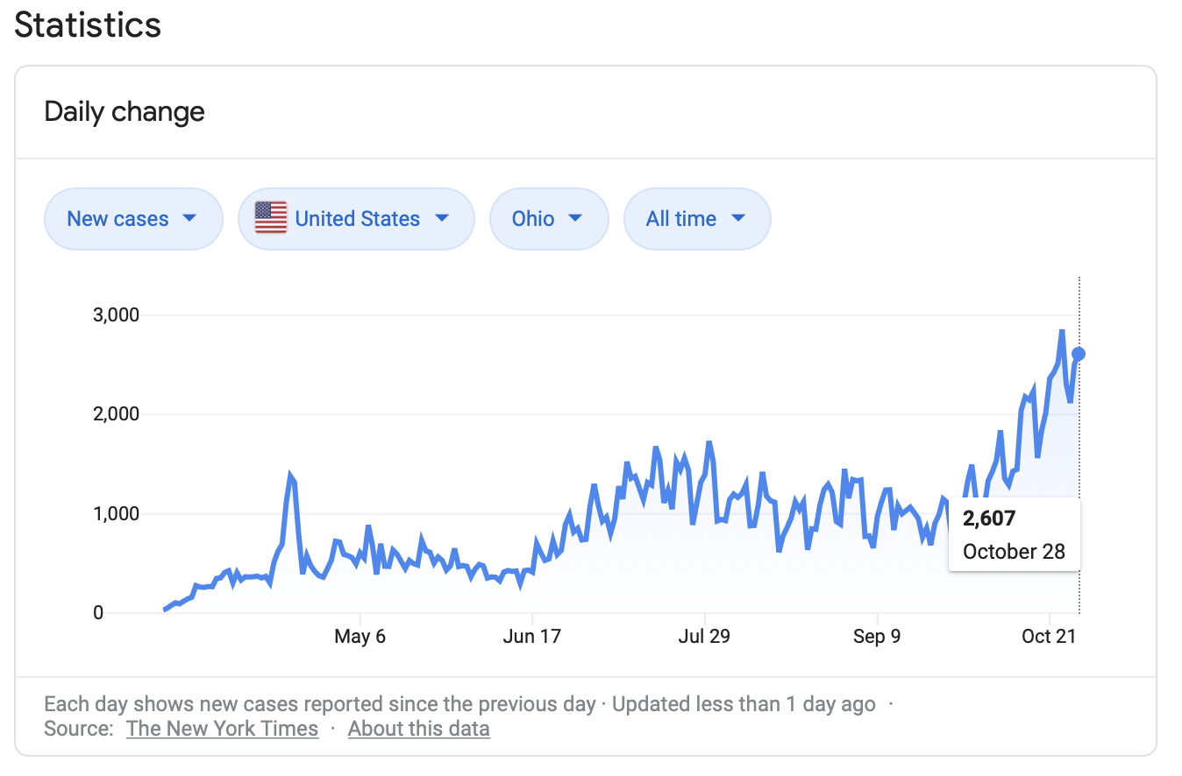
announcement
Stay safe!
Stay healthy!

Slide 3
agenda
Review of lecture
Activity
Hypothesis testing
One sample z test
Impact of alpha level
Impact of sample size
In class exercise
Stata

Slide 4
Hypothesis testing
Single mean test vs two means test
Single mean test: test population mean in relation to a hypothesized value
Two means test: test whether population means from two populations differ
H₀ (Null hypothesis)
No statistically significant difference between the test population and hypothesized mean, or between two population means.
H₁ (or H_{a}, Alternative hypothesis)
Statistically significant difference between the test population and hypothesized mean, or between two population means.
Notes:
Walrus

Slide 5
Steps for test hypothesis
State
State hypothesis (H₀ vs H₁)
Sig.
Set significance level ($α$), decide critical region
Set significance level (𝜶), decide critical region
Calculate
Collect sample and compute test statistics
Decide
whether reject / fail to reject H₀

Slide 6
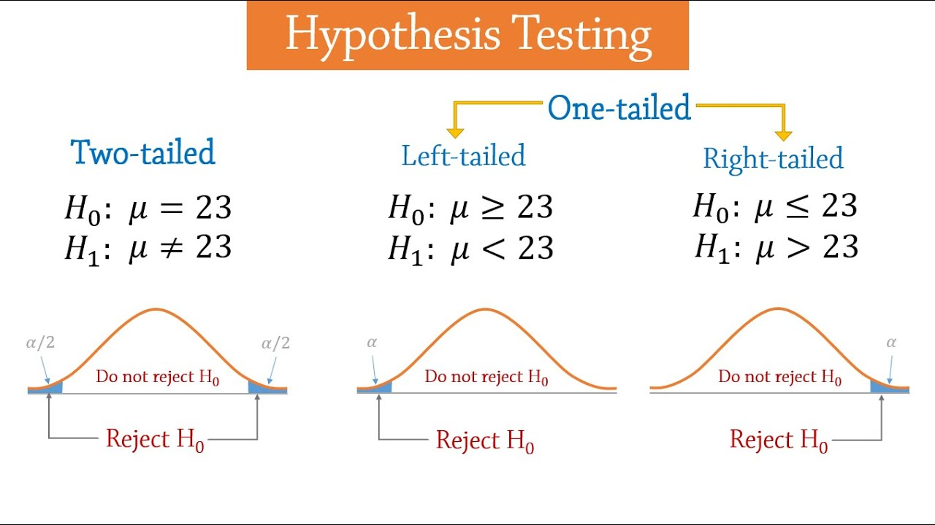

How to set h₀
 | Two-tailed | Left-tailed | Right-tailed
H₀ | Equal | No less than | No greater than
H₁ | Not equal | Less than | Greater than
includes equality
Birth weight example
H₀: Mean birth weight $μ ≥3.5$ kg.
H₁: Mean birth weight $μ<3.5$ kg.
One-tail testing (left-tailed)
Notes:
includes equality

Slide 7


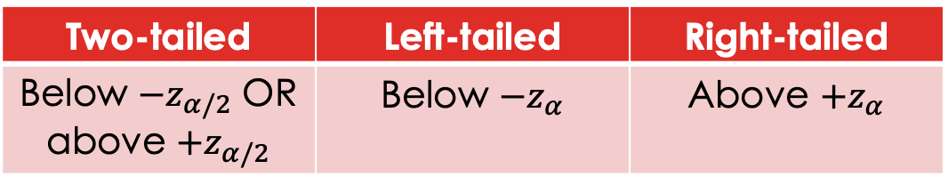

Critical region
Two-tailed | Left-tailed | Right-tailed
Below ${−z}_{α/2}$ OR above ${+z}_{α/2}$ | Below ${−z}_{α}$ | Above ${+z}_{α}$
Region of rejection of H₀ at chosen $α$ level.
Defined by critical value(s).
You’re essentially testing:
whether z-score for sample mean is more extreme than z score for selected $α$

Slide 8
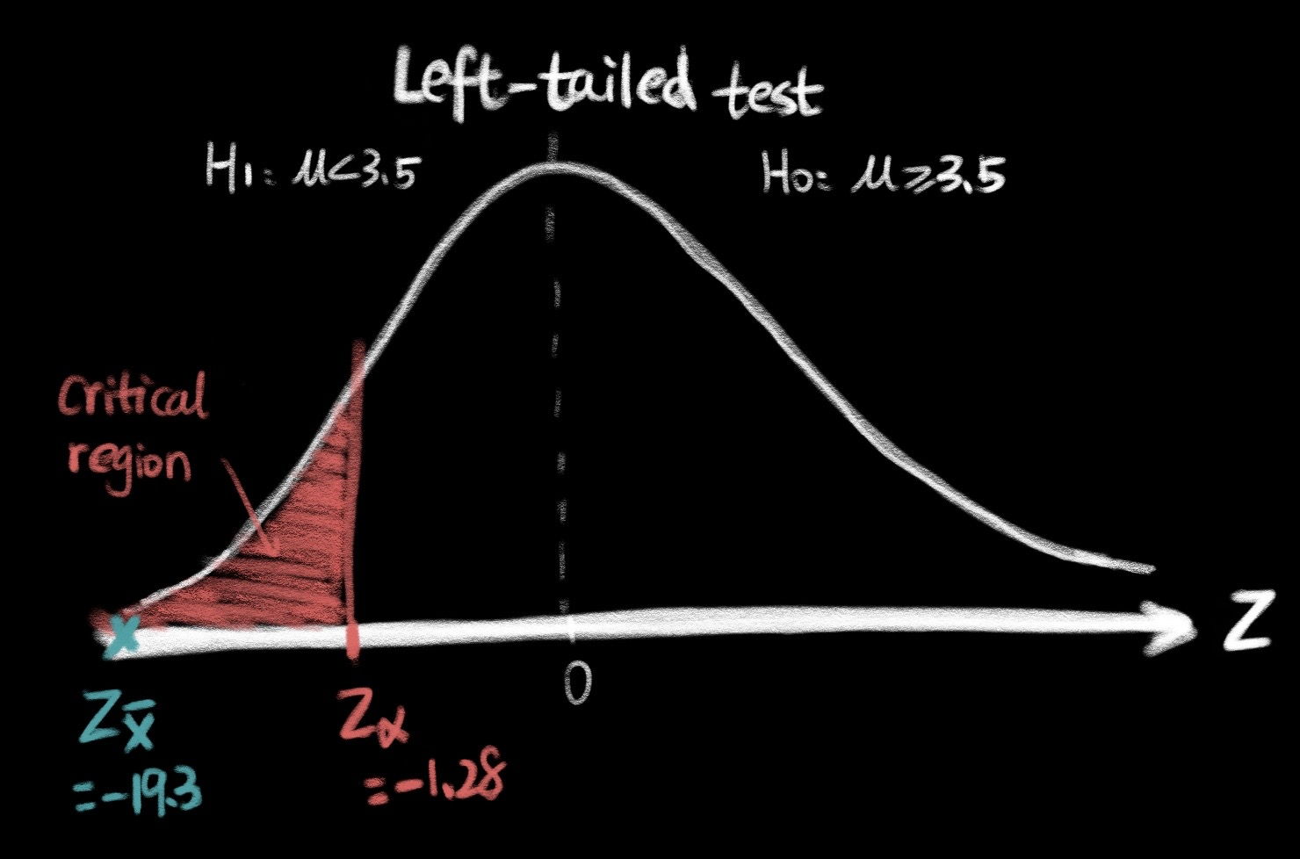
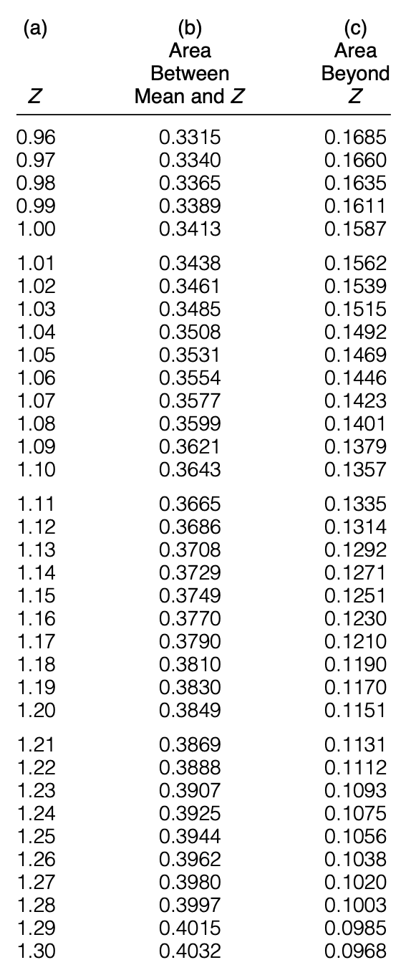
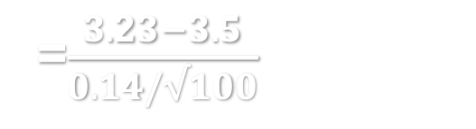

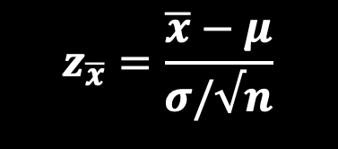



One-sample Z-test
Find critical value ($z_{α}$, $z_{α/2}$)
Compare $z_{\overline{x}}$ to critical value
Set significant level $α$
Identify critical value:
One-tail ($z_{α}$)vs two-tail ($z_{α/2}$)
Find z for $α$($or α/2$) in Appendix A
$$z_{\overline{x}}=\frac{\overline{x}−μ}{σ/√n}$$
=$\frac{3.23−3.5}{0.14/√100}$= -19.3
Reject H₀ at $α$=0.1 level

Slide 9
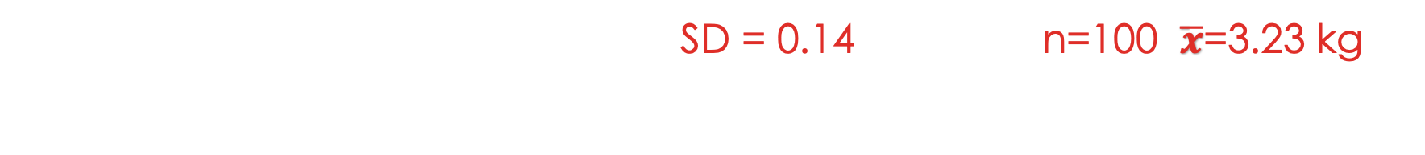

Complete hypothesis testing process
Birth weight example: Population SD = 0.14; sample: n=100, $\overline{x}$=3.23 kg
Test hypothesis
H₀: $μ ≥3.5$ kg vs H₁: $μ<3.5$ kg.
One-tail test, left-tailed
Set significant level at $α$=0.10 , critical value $z_{α}$ = -1.28
Z score for sample mean: $z_{\overline{x}}=\frac{\overline{x}−μ}{σ/√n}=\frac{3.23−3.5}{0.14/√100}$= -19.3
$z_{\overline{x}}$< $z_{α}$ , falls in critical region.
Based on the sample of 100 girls, at 0.10 significance level we reject the null hypothesis that mean birth weight $μ ≥3.5$ kg.
Using a 90% confidence level, we think mean birth weight $μ<3.5$ kg
Statement
Sig. level
Calculate
Decide

Slide 10
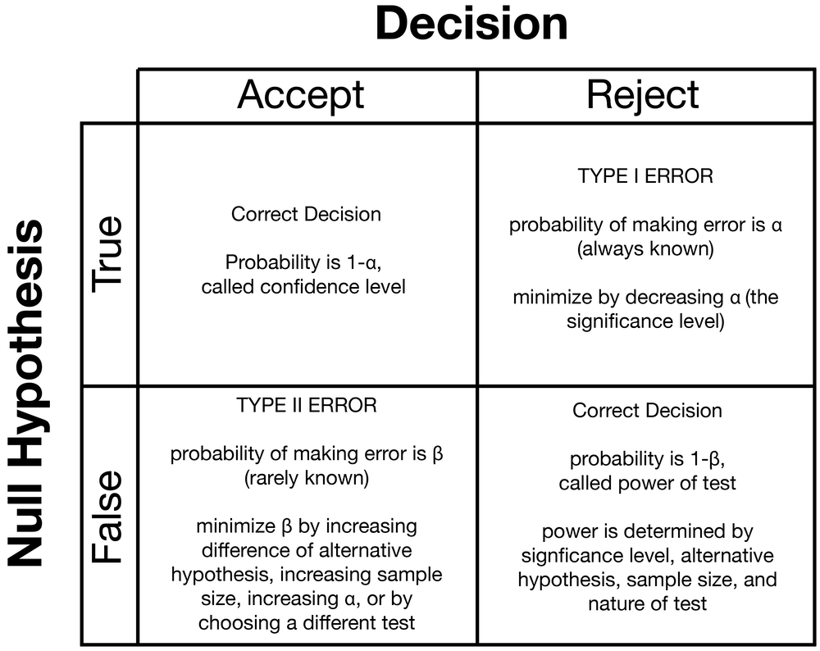
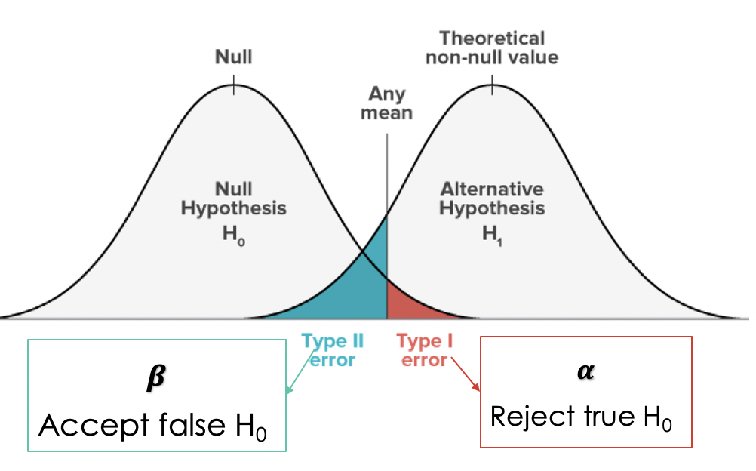
Type of errors
Threshold

Slide 11
How to reduce error
Smaller alpha
If we reduce alpha, the probability of making type I error is lower, we are more confident that the sample statistic can accurately estimate population parameter, therefore it becomes harder to reject the null hypothesis
Increase sample size
The bigger the sample size, more information we have about the population, the sample statistics are more accurately approximate population parameters

Slide 12
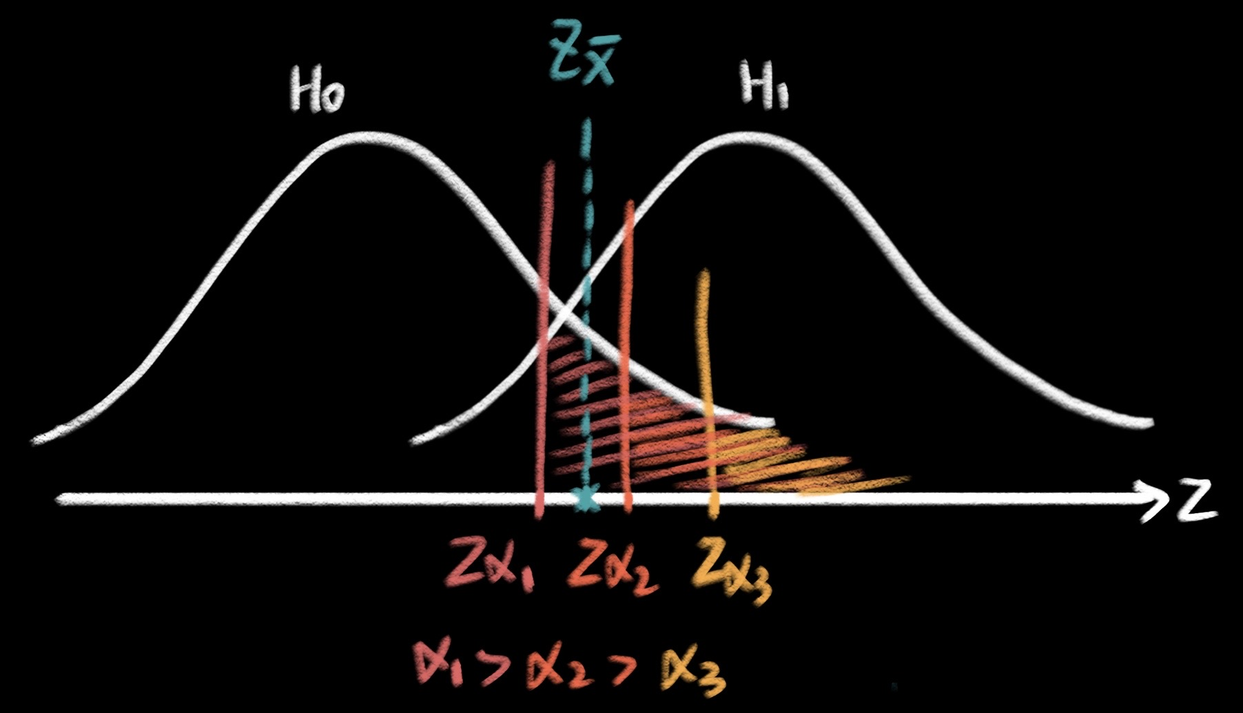

reduce type I error
↓ significance level $α$,
↓ the probability of making type I error
↑ confident that the sample statistic can accurately estimate population parameter,
↑ harder to reject the null hypothesis

Slide 13
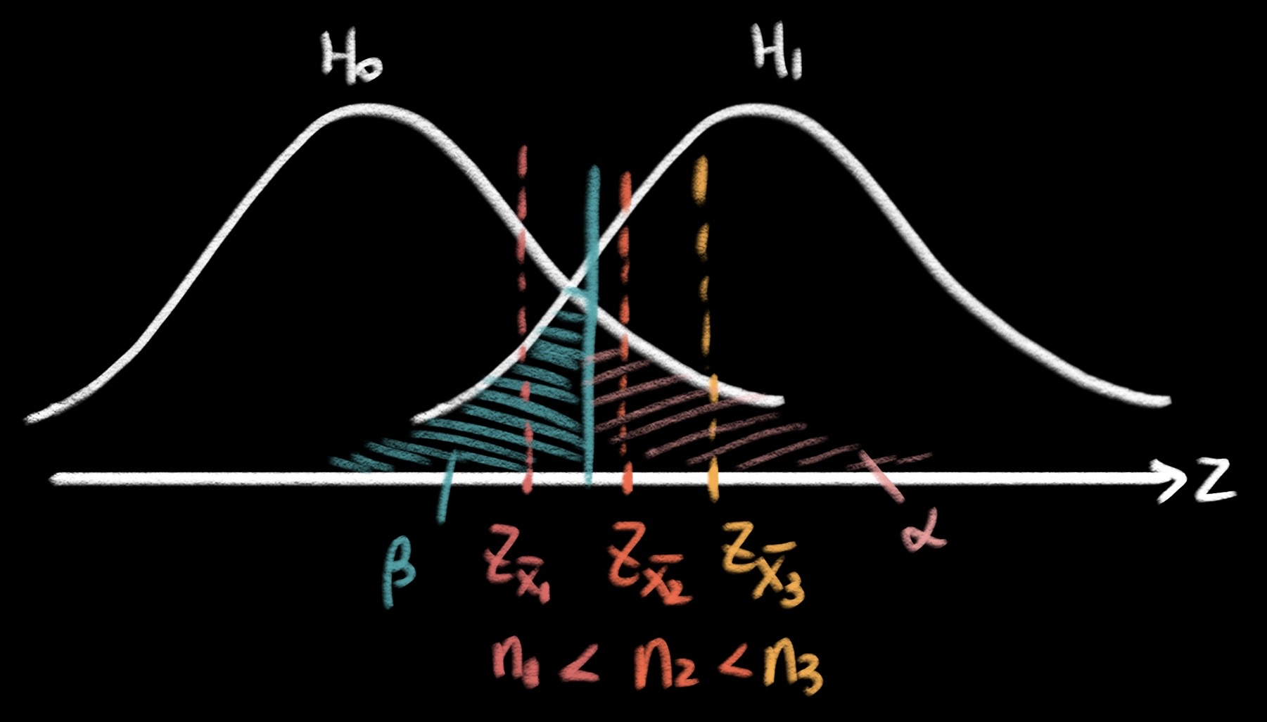

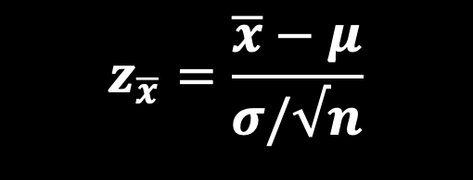
reduce type II error
$$z_{\overline{x}}=\frac{\overline{x}−μ}{σ/√n}$$
↑ significance level $α$
keeping $α$, ↑ sample size
hypothesis test is more sensitive
more likely to reject the null hypothesis when it is false
↑ power of the test ($1−β$)
↓ the probability of making type II error ($β$)

Slide 14
stata
Please make sure you’ve downloaded do file and GSS data file to remote lab desktop. We will use Stata today.

Slide 15
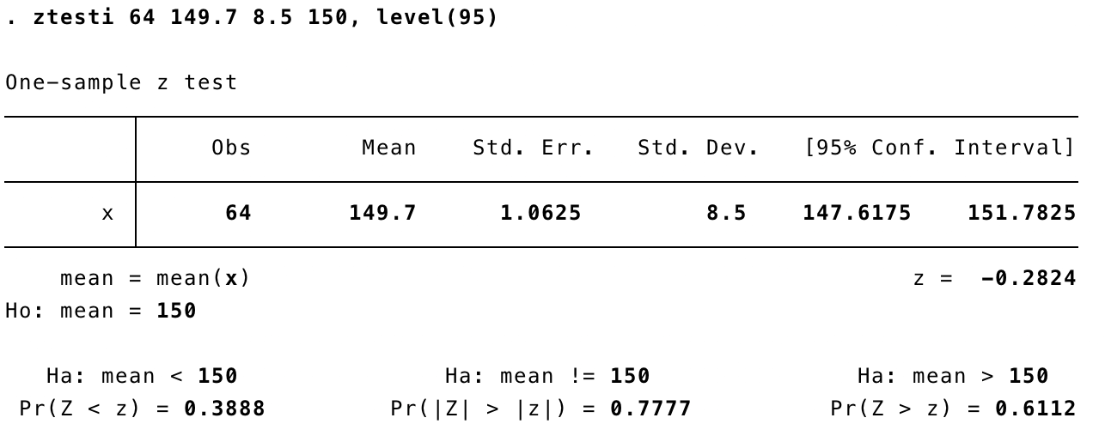


Stata: one sample z test from summary statistics
ztesti <sample size> <sample mean> <population SD> <hypothesized mean>, level(<confidence level>)
Confidence level is 1- $α$
$$z_{\overline{x}}$$
Two tailed z-test
One tailed z-test
One tailed z-test
Reject null hypothesis if this value is less than your pre-specified $α$ level.

Slide 16
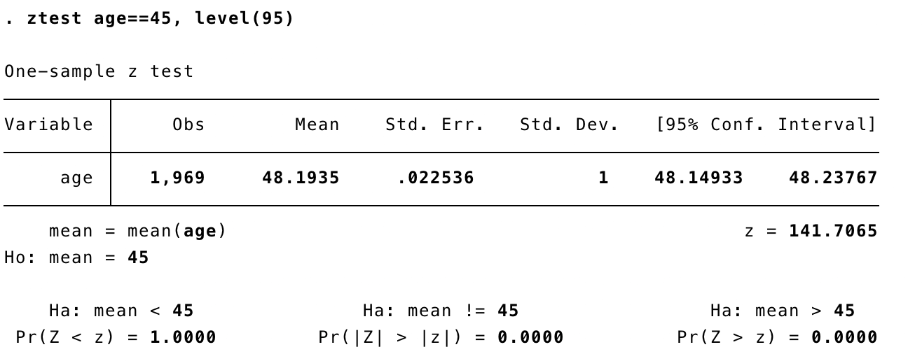


Stata: one sample z test from variable
ztest <variable> == <hypothesized mean>, level(<confidence level>)
Confidence level is 1- $α$
$$z_{\overline{x}}$$
Two tailed z-test
One tailed z-test
One tailed z-test
Reject null hypothesis if this value is less than your pre-specified $α$ level.

Slide 17

In-class exercise
Use Stata to double check your exercise results from week 8 & week 9
Upload Stata log file to Carmen - Lab attendance for today.
Birth weight example
Week 8 question: birth weight SD = 0.14, you took a sample of n=100 newborns with sample mean $\overline{x}$=3.275. Calculate 90% confident interval.
Week 9 question: birth weight SD = 0.14, you took a sample of n=100 newborns with sample mean $\overline{x}$=3.23. Test hypothesis that US girls has mean birth weight no less than 3.5 kg, at $α=0.10$.
Notes:
Test hypothesis:

